Slide 1
Price Optimization
&
Sales Analysis: Understanding Pricing Dynamics
of
Cabernet Sauvignon

Slide 2
Agenda
Evaluation
Interpret Models & Findings
Offer Recommendations
Deployment
Model Building
Test & Validate Models
Preparation & Planning
Data Overview
Highlight Findings & Insights
Building the Foundation
Exec. Summary
Business Problem & Objectives
Notes:
Mason : Exec Summary, Data Finding
Jonathan : Model 1,
Allika : Model 2,
Sneha ; Data Findings/Trends/EDA, Challenges
Pakshal : Data Findings/Trends/EDA, Challenges
Jackie : Time Series forecasting products, Recommendations

Slide 3
Building the Foundation

Slide 4
Executive Summary
Purpose
The retail industry is a competitive landscape that requires constant innovation to stay ahead of competitors. With expansion in mind, being prepared to serve customers across the nation is a high-level process.
Objectives
We were tasked with building a practical and effective price optimization model using historical Cabernet Sauvignon sales to formulate an actionable strategy.
To understand how consumers react to product pricing strategies, we examined own price elasticities and cross-price elasticities.
Outcomes
Our two best models that adequately predict sales combined with statistical analyses lead to our recommendations for Cabernet Sauvignon pricing.
Largest independent wine retailer in the United States of America

Slide 5
Business Problem
63%
Americans reporting alcohol consumption
With 63% of Americans consuming alcoholic beverages, pricing is a key factor in maximizing consumer demand
With over 4,000 Cabernet Sauvignon products, there is the challenge of continuously monitoring these prices

Slide 6
Business Objectives
Cab Sav is the King of Red Wine
Key Revenue Stream
Keen Interest in its Pricing Strategy
What do the price elasticities tell us about the products? Is there an overall observation that prevails?
What are the important factors that impact sales? (i.e. season/holidays, promotion, etc.)
Is there one model that performs to an ‘acceptable’ standard? Can we digest the models and explain their complexity?

Slide 7
Preparation & Planning

Slide 8
Data Sources
Data Summary
Regionality of Wine
Product Names
Unshared
Cabernet Sauvignon Dataset
(11.6 million rows x 10 columns)
4,101 unique Cab Sav’s
254 Stores in 28 states
69 Price Zones
4 year period (2020-2023)
Consumer Price Index (Alcoholic Bevs)
(45 rows x 2 columns)
US Bureau of Labor Statistics/FRED
Monthly CPI (Jan. 2020 - Sept. 2023)
State Alcohol Consumption (per capita)
(50 rows x 3 columns)
World Population Review (2020-2022)
CPI (Alcoholic Beverages)
Alcohol Consumption per capita
Supplemental
Cabernet Sauvignon Dataset
Primary

Slide 9
Data Cleaning
Removed entries where sales quantity, revenue, and discounts were negative (indicating returns), retaining only positive values, which reduced the dataset by 5%.
Remove
Our dataset initially had 4000+ unique ITEM_KEYS. We emphasized the top 40 ITEM_KEYS, reducing the dataset by about 90%
Filter
Converted variables STATE_ABBR, PRICE_ZONE_NAME, FISCAL_WEEK, and FISCAL_YEAR into categorical columns or applied one-hot encoding/ label encoding to make them suitable for analysis.
Convert
Aggregated certain variables like SALES_QUANTITY, PRICE, DISCOUNT_% based on specific model considerations. (e.g., sum, mean, max)
Aggregate

Slide 10
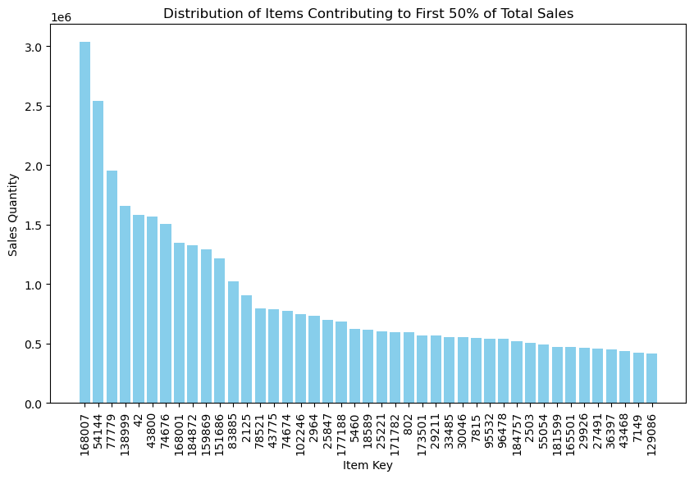
43 of the 4,000+ Cabernet Sauvignon’s drive half of all sales.
These products are key to maximizing customer demand!

Slide 11
Data Preparation
EDA
TFT Model
RNN Model
SALES DATASET
11.5 million rows X 12 columns
4,101 unique Cab Sav’s
4 year period (2020-2023)
Properties
Exclusive of returned products
Given Price and Total Discount %
Usage
Data for trends and analysis
TOP PRODUCTS DATASET
Top 43 products are selected
Aggregate sales across all stores
Discard discontinuous time series
Properties
Sales Quantity over all years
Individual store location not significant on forecasting
Sensitive to discontinuity
Usage
Forecast sales quantity
TOP PRODUCTS DATASET
Top 40 products are selected
Aggregate sales on Price Zones
Took a 30 week time series window
Properties
Sales are grouped by sum
Unit Price and Discount % are grouped by average
Usage
Predict sales quantity

Slide 12
EDA
Findings & Insights

Slide 13
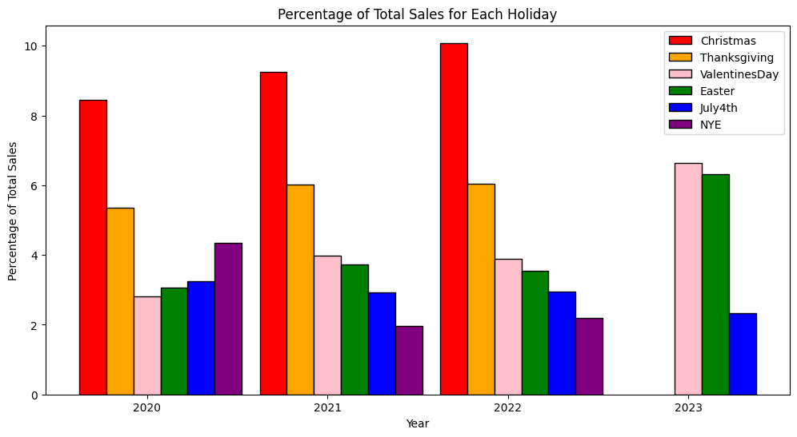
Certain Holidays are a time for wine consumers to stock up for the special date, thus accounting for chunks of sales dollars and quantity throughout the year.

Slide 14
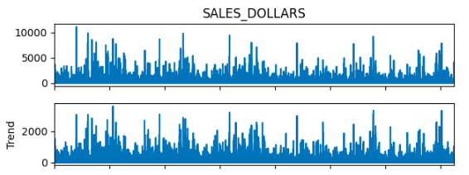
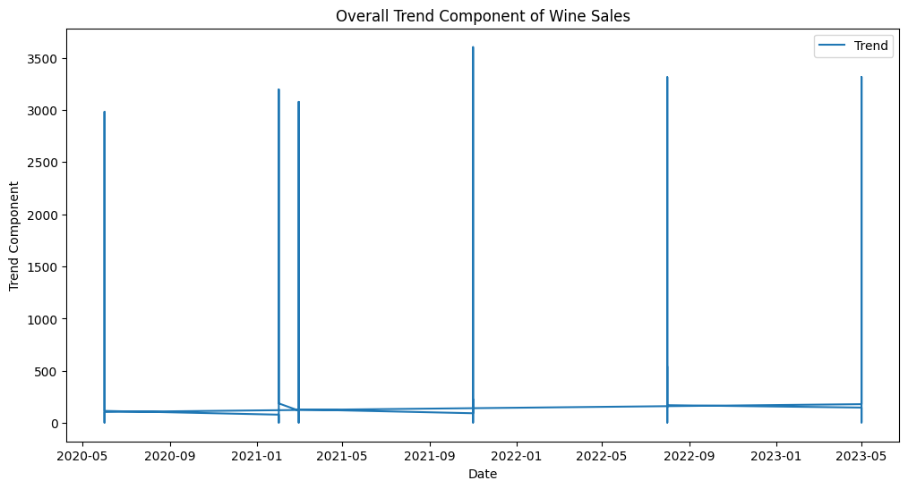
Consumer Price Index of Alcoholic Beverages suggests a weak linear relationship with Sales Dollars from 2020-2023.
Correlation Coefficient: -0.011527
As CPI increases - Sales tend to decrease, but very minimally
Seasonal Decomposition: Trend Component
This is the long-term pattern in the data, the underlying direction in which the data is heading
Narrow spikes in the trend component indicate periods of significant variation or peaks in the sales data

Slide 15
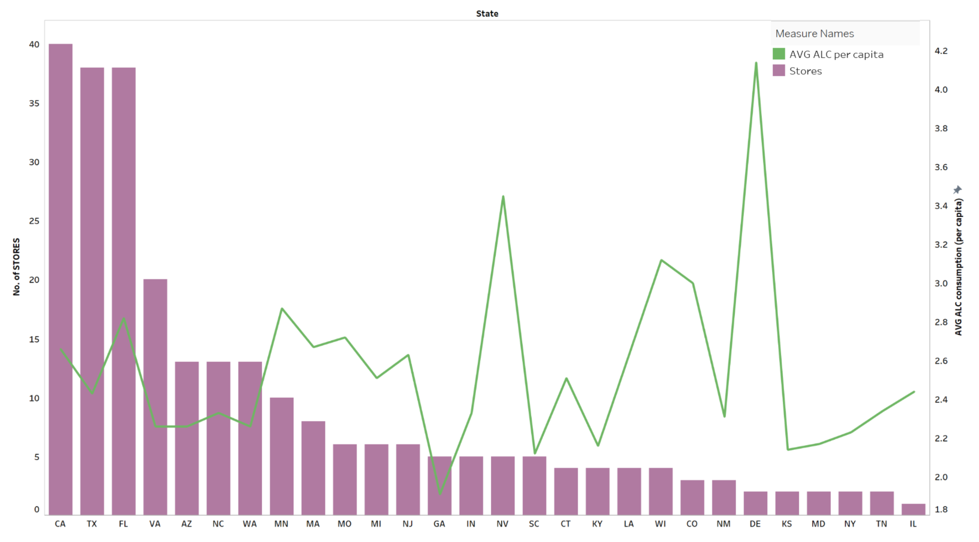
Average Alcohol Consumption Per Capita does not seem to correlate with the total number of stores in a state. (many other factors could have more of an impact)
Notes:
Could be a good metric to look at for Total Wine with expansion

Slide 16
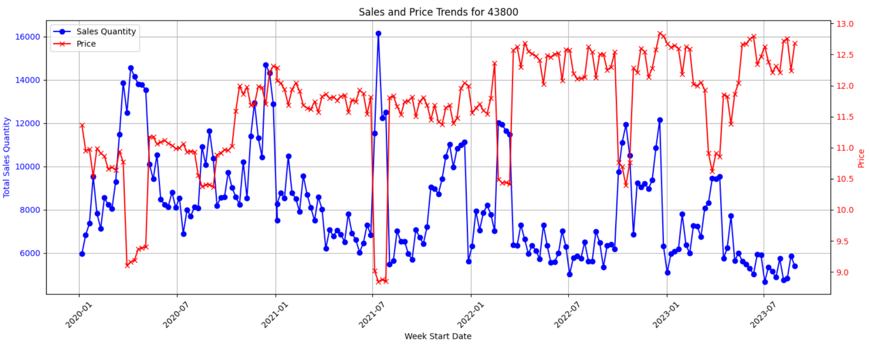
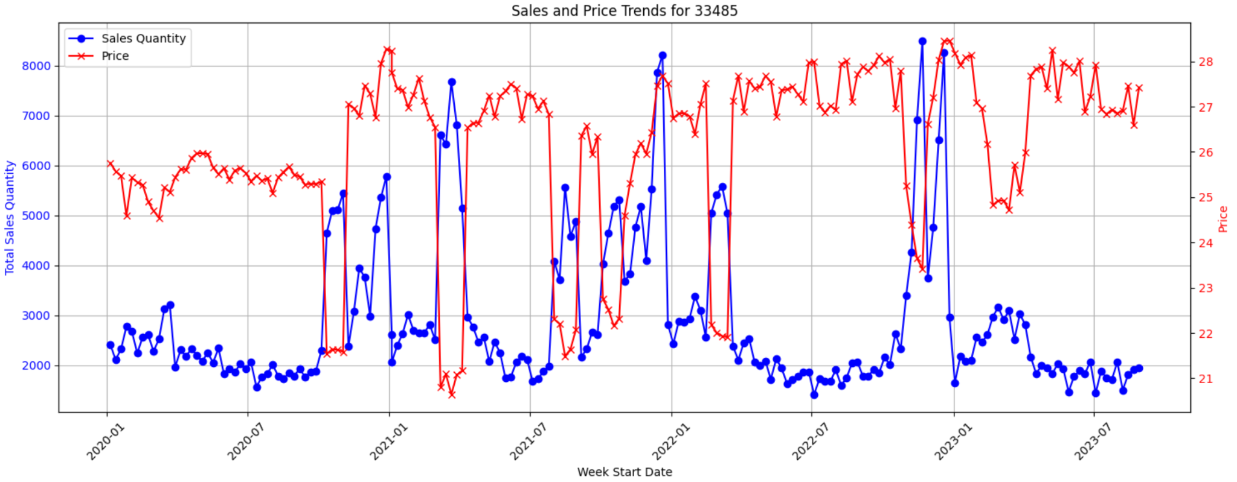
Price Sensitive and Insensitive Products
Price Sensitive products throughout the year:
Item Keys
95532
83885
184872
15859
78521
43800
43775*
Price Insensitive products throughout the year:
Item Keys
802
33485
96478
159869
43775*
Notes:
Could be a good metric to look at for Total Wine with expansion

Slide 17
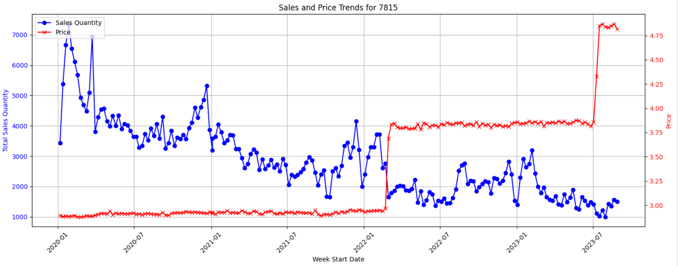
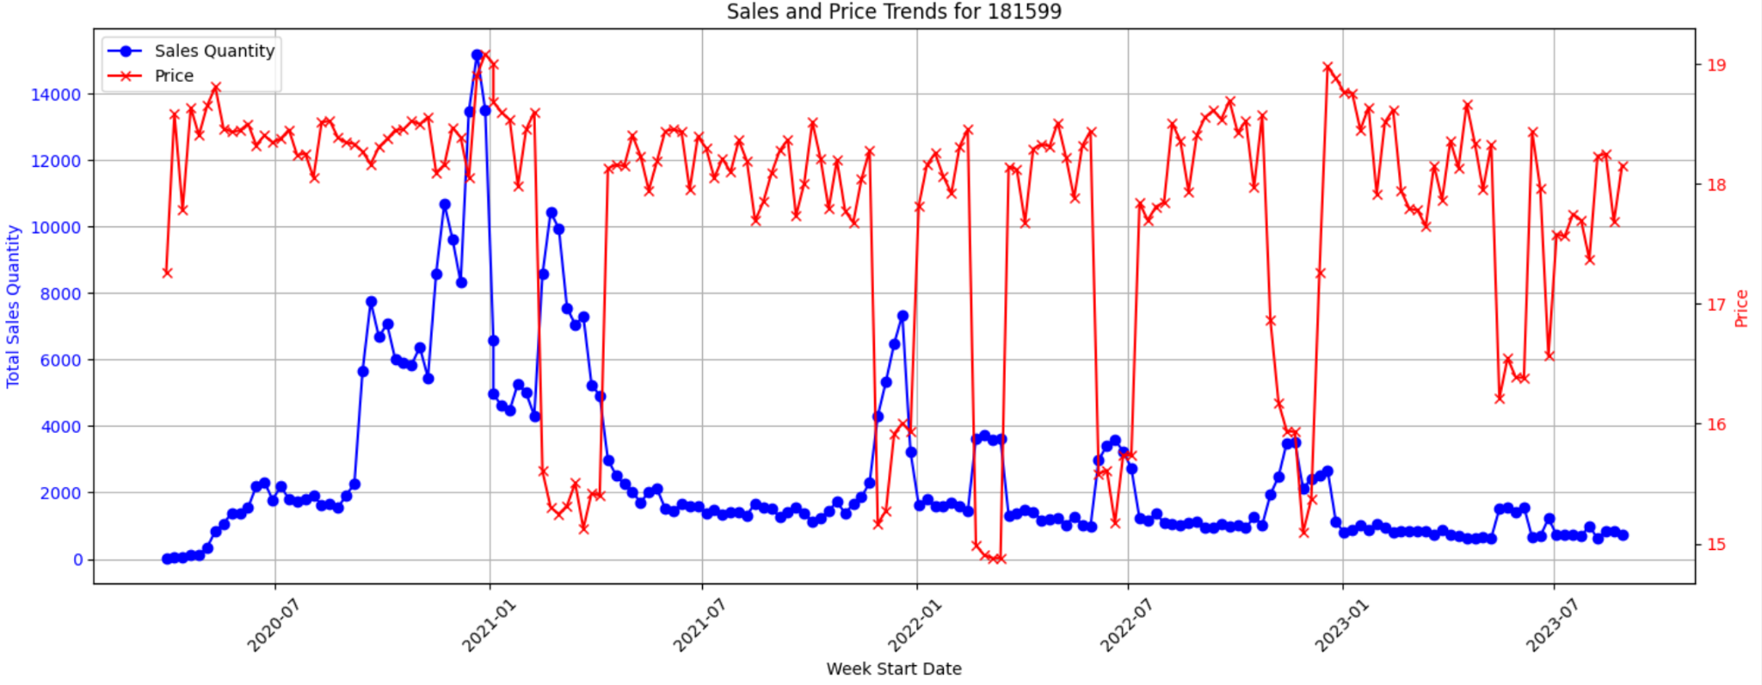
Price vs Sales Quantity Anomalies
Notes:
Could be a good metric to look at for Total Wine with expansion

Slide 18
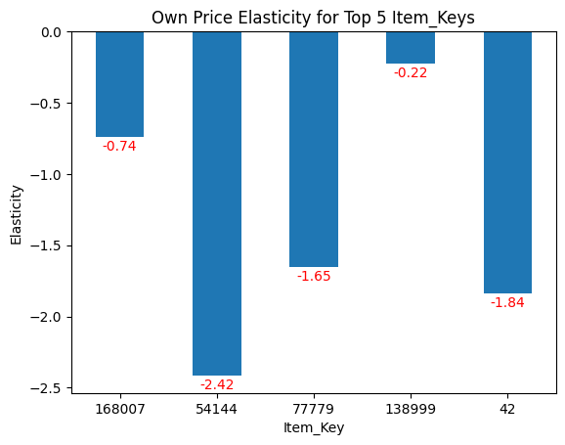
The Top 5 Generating Cab Savs all have Negative Own Price Elasticities
Item Key | Elasticity
168007 | -0.74
54144 | -2.42
77779 | -1.65
138999 | -0.22
42 | -1.84

Slide 19
Deployment

Slide 20
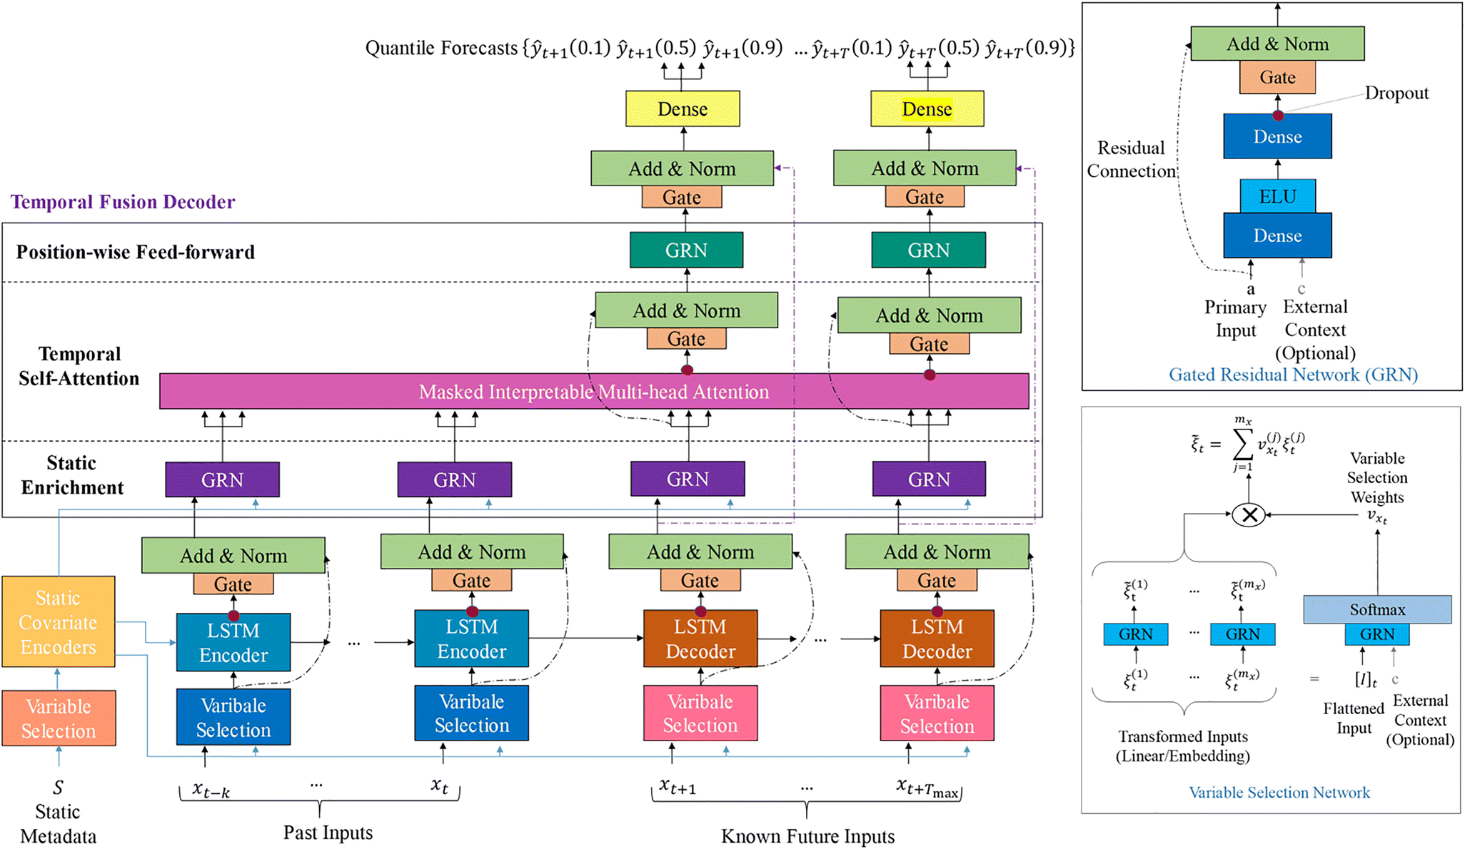
Model 1: Temporal Fusion Transformer (TFT)
Time Series Forecasting
Multiple store sales records
Seasonality and trend
Extensive data (over 10M sales records)
Advantage of TFT
Built to handle complex dataset (Transformer based)
Handling of Heterogeneous variables (Holiday, Discount rate)
Multiseries capabilities (Multiple Item Store combination)
Capturing Temporal Dynamics (Seasonality, Trend)
Feature Selection
TFT model structure
(developed by Google Cloud AI and the University of Oxford)
Notes:
Okay now lets talk abou tout model, I build a model called tft, specifically designed for solving complicated problems. For the dataset provided by total wine there are 3 major challenge posed: there are multiple sales time series records for each store and item combination, for each of the product its sales in different store is an independent time series, this problem can’t be easily addressed by traditional time series model like ARIMA, which handles one time series at a time, second, the sales quantity demonstrate a strong seasonality, simple model like regression model also can’t handle this challenge very well. What’s more there is a datasize challenge, the data provided is very complicated. Our model has over 10m rows and sales records of over 4000 products across all stores in the united states. Considering the complexity of the problem, I found a model perfectly for this task: TFT: TEMPORAL fusion transformer model, this is a fancy model, not just with its name, but also with its capabilities. It can handle complicated model just like chatgppt, because tft and chatgpt share same structure transformer, which is capable of handling complicated relations. Second it can handle exterogenous variables, unlike armia, which can only give forecast for a simple time series, tft can include non time seres data such as holiday, discount rate, unit price into the model, and this is what we need. Third this model can handle multiple time series, for each item its’ time series in different store can be recognized by the model, this is far superior. Also it can capture temporal dynamics just like arima model. Last it can handle feature selection and give importance of features using its variable selectiuon structure,

Slide 21
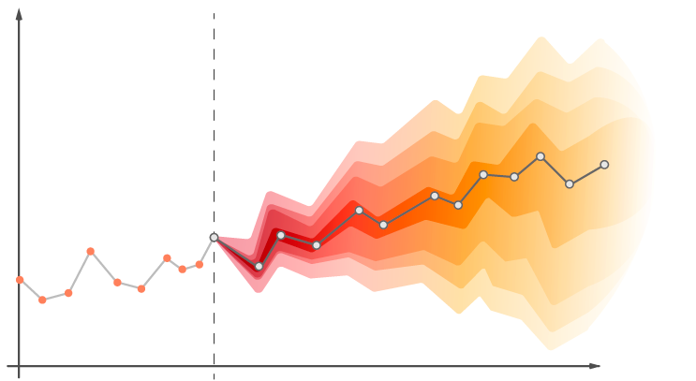
Task and Variable Selections
Task
Based on 1 year historical data to forecast one months sales with future known variables
Variable
Target variables Total_sales_quantity
Group_ids ITEM_KEY
Time_varying_known FISCAL_YEAR & WEEK, Holiday, LTS_RATE, TOTAL_RATE, UNIT_PRICE
Notes:
Then lets talk about what i did with the model, after variable importance analysis, the model decided store is not important in prediction, thus i just aggregate sales of all stores that reduces noise and by central limit theorem, you know that sale quantity after aggregation is more stable, thus it is easier for model to handle. After that the data is being fed into the model, there are 3 kinds of variables the model needs: target variables, it is the variables we are trying to predict, Group_id the variable built for machine to recognize different time series for different products. Time varying know, it is fical_year, holiday, lts rate total rate adn unit price. So why not call time varying know variable numerical variables, what does known mean, this know mean these variable values are know in the prediction window in to the future, in the prediction phase, it will give prediction not just based on historical data, but also relying on future know values such as discount rate and holiday in the future. This gives another advantage for the model, what is scenario analysis, we can adjust future discount settings to see how it impact sales,I’ll demonstrate that later

Slide 22
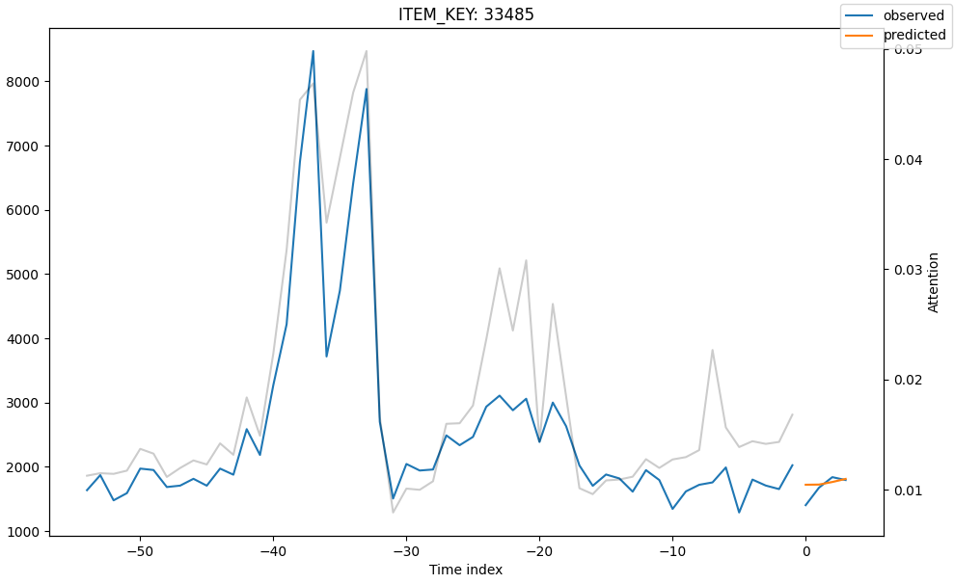
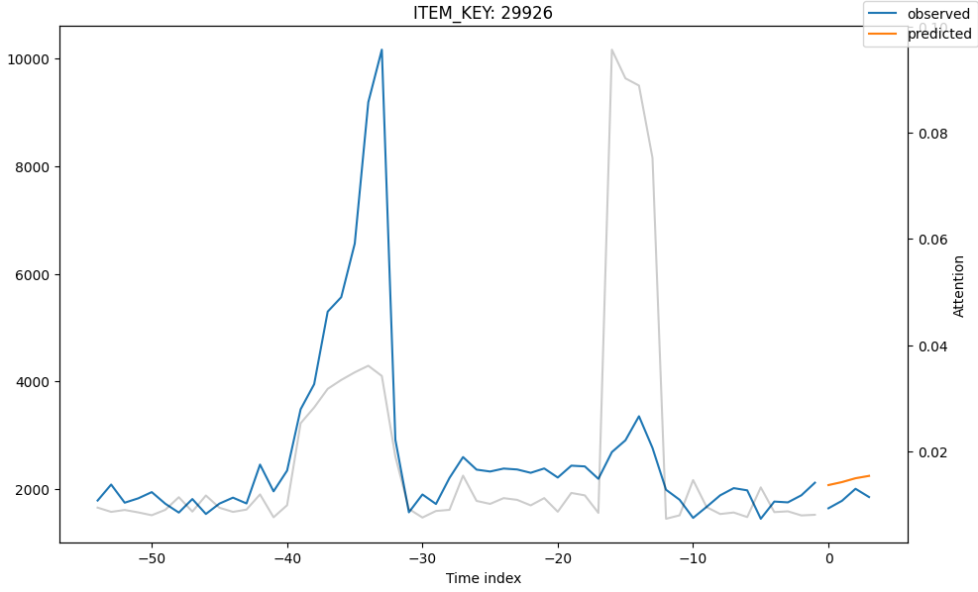
Forecast Results
Low SMAPE rate achieved in 6 epochs (0% indicates perfect accuracy, value: 0~200%)
Forecast examples
Notes:
Okay, after all thes talk, what is the performance of the model. As it turned out, it is performing really well, the SMAPE value is 0.17 for training dataset, for smape 0 means perfect prediction, and 200% represents worst prediction, 0.17 is a pretty good value and as you look at these sample graphs. The line in yellow is very close to actual sales, the line in blue. Aslo there is no over fitting problem in other models, in our project, we have tried some traditional models and they suffer from overfitting very badly. Talking about the graph. there ‘s one more interesting thing to mention, that is the grey line, that represents attention. It tells us how much attention the model is paid when it made the prediction as you can see here, the grey line matches well with sales peaks, which may be huge promotion date, or holiday, anyways thats that involves holiday and price change, for price change, it comes with elasticity, so I think it demonstrates the model capability to interpret seasonality and holiday importance

Slide 23
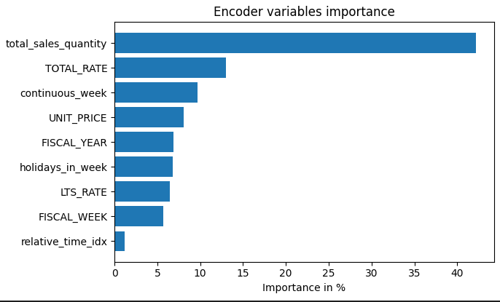
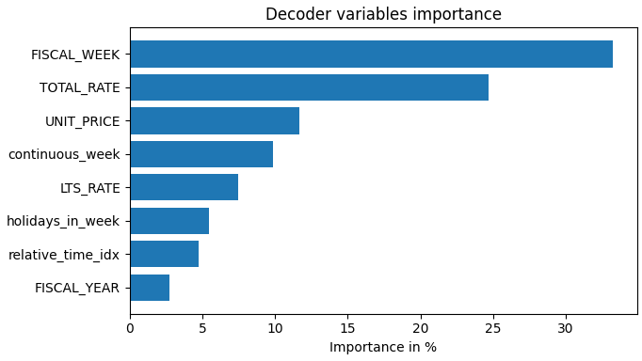
Variable Significance
Variables significance charts generated by TFT model
Notes:
Next slides show you some of variables importance chart, this chart demonstrates how much importance the model is assigned when giving prediction, the chart of the left encoder variables, which means variables that pass to model before the prediction horizon, in our case past 1 year data, you see the model pays a lot of attention to historical sales, and discount rate. The chart of the right is called decoder variables, this is the variables that feed fed into the model in the prediction horization, this is what i talked about, time_varying_know variables, these values are know before hand such as holiday or can be set by human such as discount rate, thus we can conduct a scenario for future scenarios with different discount rate. As you can see fiscal week, which can capture seasonality pattern and total rate are the most important in future prediction.

Slide 24
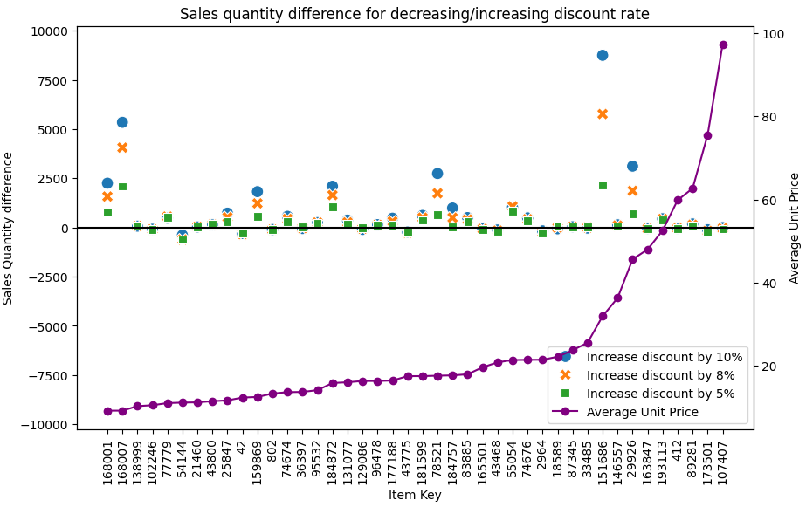
Scenario Analysis
Increase Discount Rate by 5%,8%,10%
Notes:
Then I’ll give you some samples of scenario analysis, this is the chart showing how product product sales increase in different discount rate, here it is 5%,8% and 10%, scenarios, the blue dot is 10% discount rate,, orange cross is 8% and 5% is 5% discount, as you can see here, there is a general pattern, higher discount rate means higher sales increase, but there are also cases when product is not responsive to price change, especially the ones with high price, they are unresponsive to price change.

Slide 25
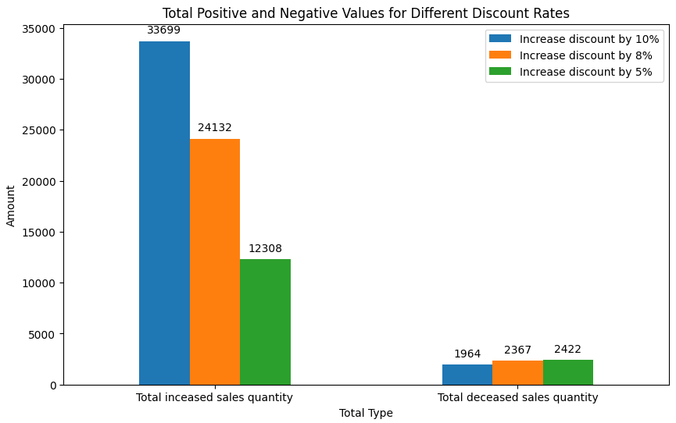
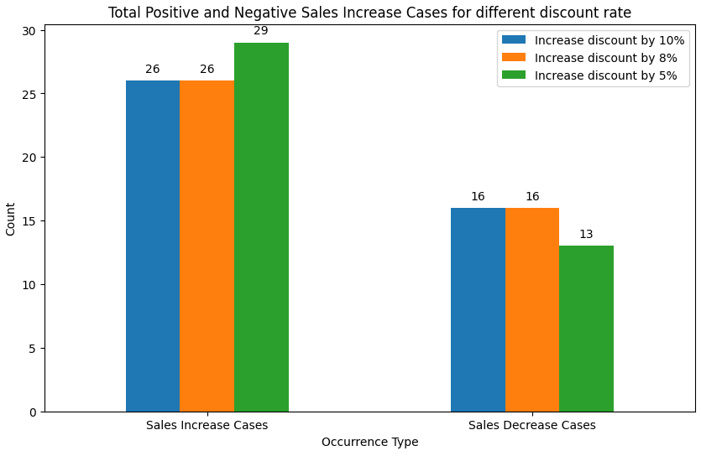
Scenario Analysis
Notes:
To dig deeper i created this chart to show how much product sales can be created by increase discount, 5% the total increase is 12k, 8% it is like 24k and 10% it is like 33k, but there is also a decrease of sales quantity. They are not much around 2000, but the chart doesn;t show the whole picture, one may just based on right picture to say, increase discount, the sales will just go up. But this is not precise. I list number of products that decrease and increase sales when there is a discount rate increase. As you can see here about 13 to 16 products w=their sales will decrease when there is a discount rate increase, which the other response positively to discount rate. This give insights for people to adjust discount rate by simply using scenario analysis, and this is also a high advantage for this model, many model only care about past history and give prediction into the future without considering future scenario, bu this model perfectly handled that

Slide 26
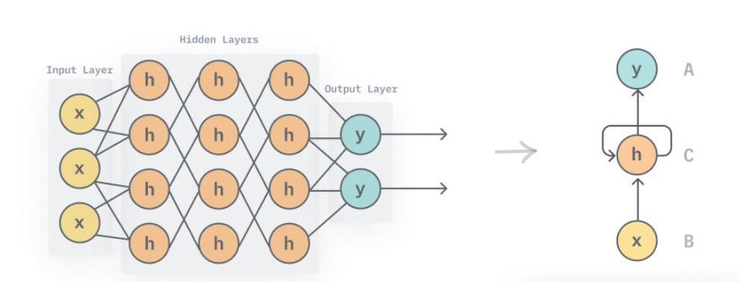
Model 2: Recurrent Neural Network using GRU
RNN is a deep learning model capable of learning the intricate relations within the time dataset.
Unlike a Machine Learning model, RNN has multiple hidden layers with its own different weights and biases.
In order to break this dataset, we have used multiple dense layers and GRU layers to learn the sequential data.

Slide 27
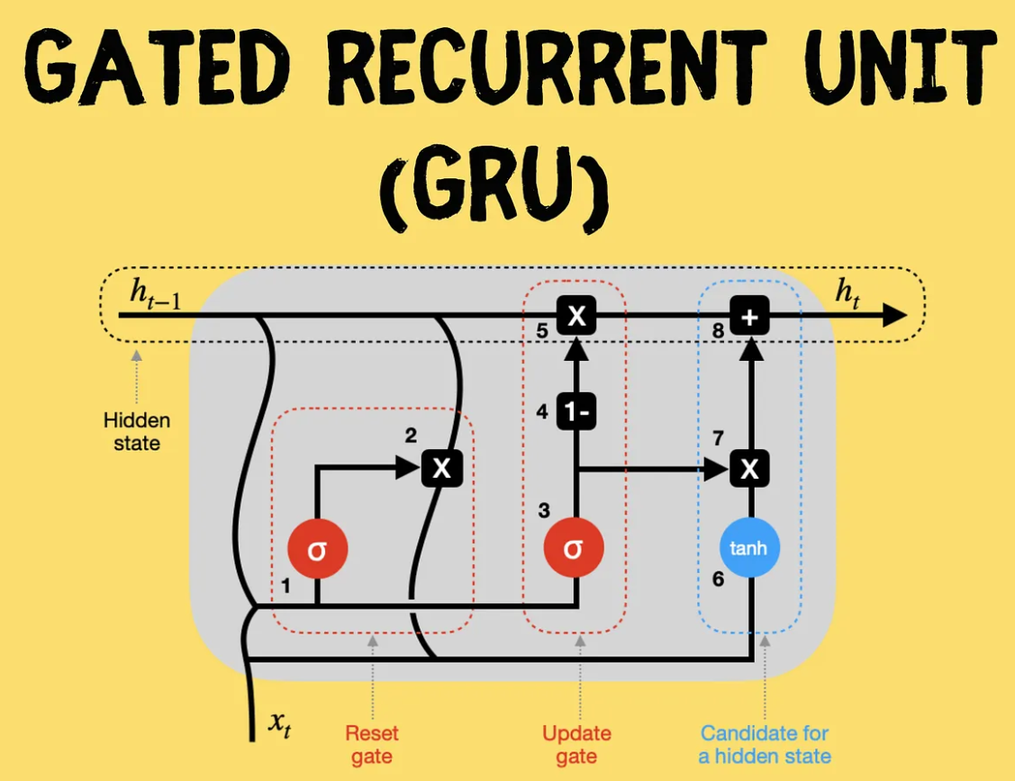
GRU is responsible for effectively capturing dependencies in sequences.
Controlling how much of the information is passed or retained make them unique.
In our case we have used 3 GRU layers stacked for understanding the time dependencies and patterns.

Slide 28
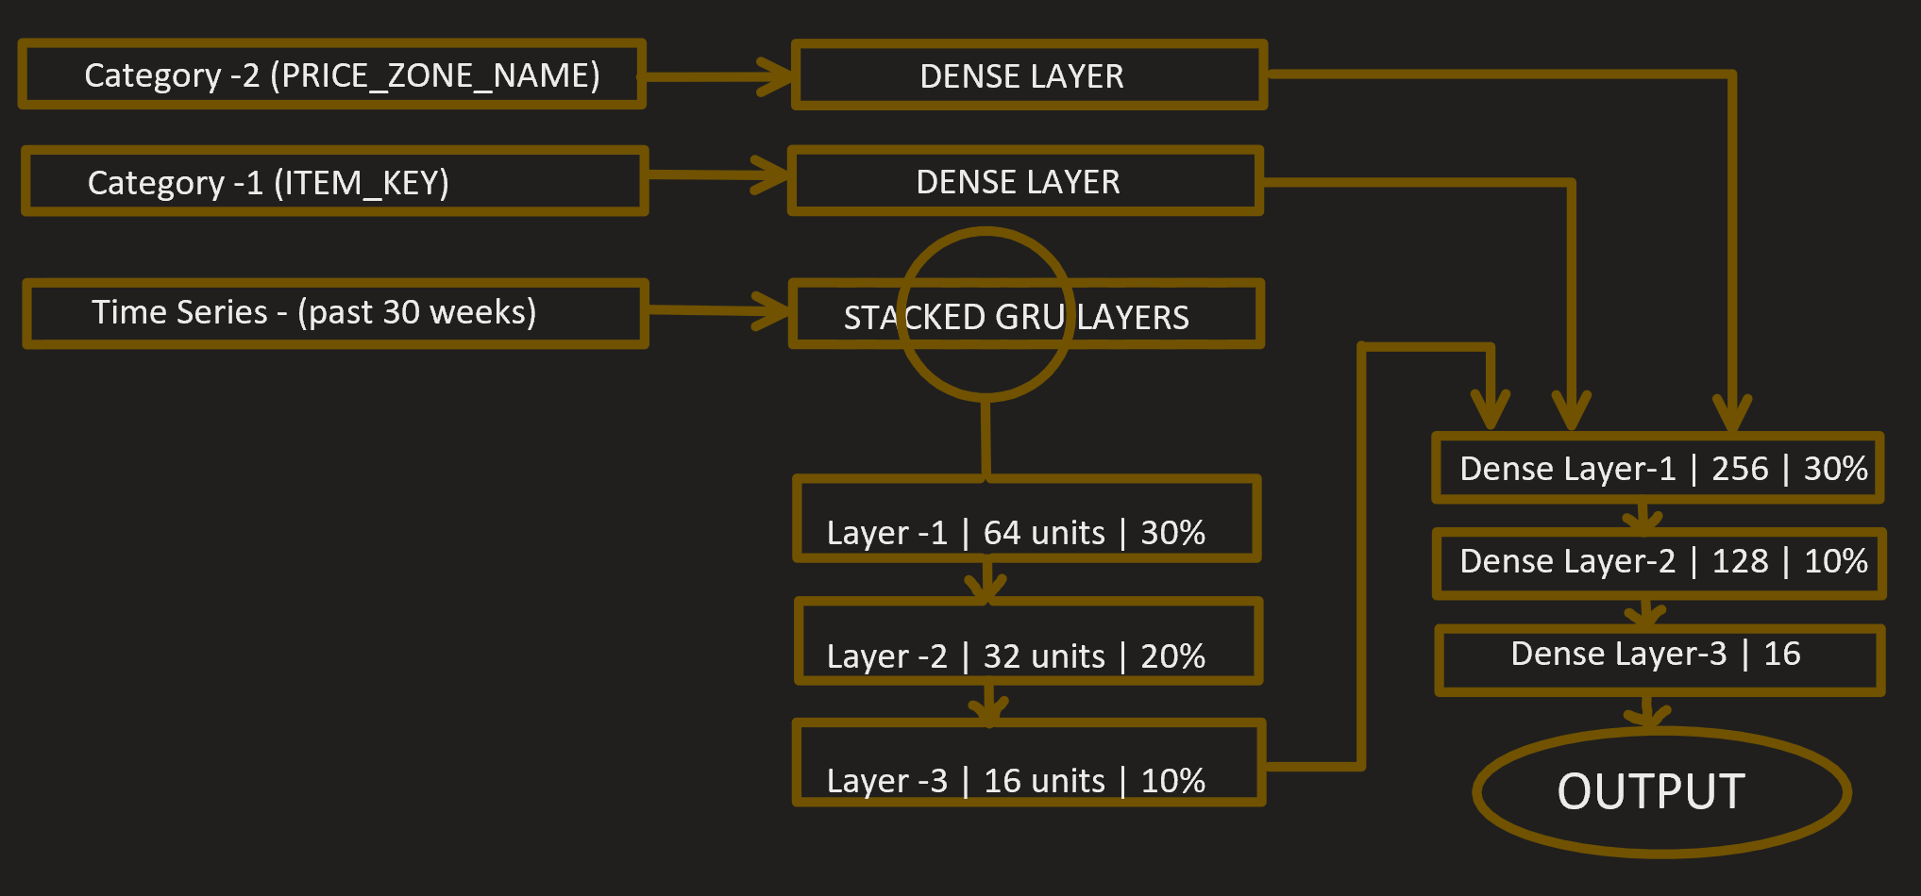
Model Structure
We start with 3 input layers, 2 for categorical and 1 for time.
Next are the separate Dense Layers for the categorical and a stacked GRU layers for t.
The combined information then goes to the Stacked Dense Layers for our output(1 step).

Slide 29
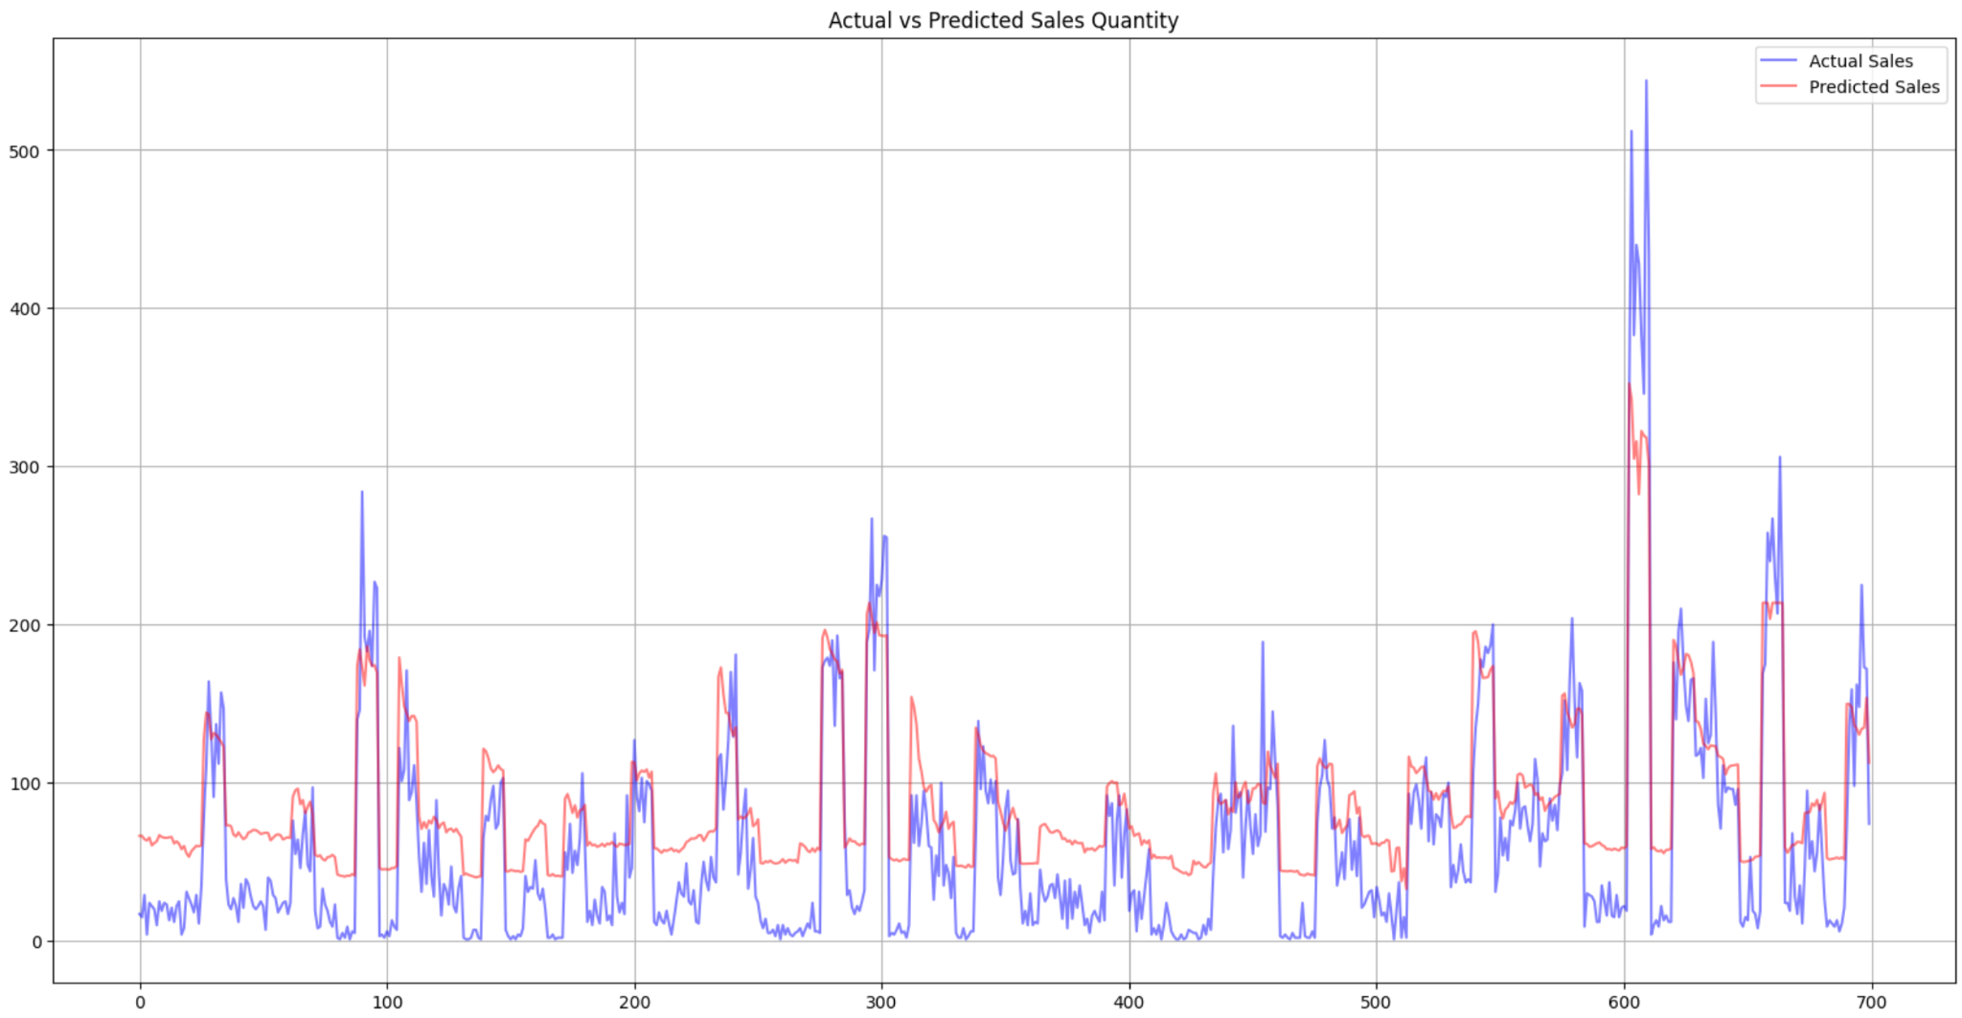
RESULTS/PERFORMANCE
Training Dataset
MSE 0.3007
MAE 0.3471
Testing Dataset
MSE 0.1454
MAE 0.3074
Validation Dataset
MSE 0.2001
MAE 0.2250

Slide 30
Evaluation

Slide 31
All Model Statistics
 | MSE | MAE | R^2
LSTM | 3650 | 157 | 0.92
XGBoost | 729 | 18.7 | 0.96
ARIMA | 1162.81 | 19.57 | 0.86

Slide 32
Challenges & Limitations
No product names/other characteristics
With other characteristics we would hope to analyze other aspects that could affect
elasticities such as regionality of wine, taste, luxury wine categories and
customer data like gender, income etc.
Discontinuous Time Series
Sales trends of products that have long periods of discontinuous data make it hard to implement into time series forecasting and limit prediction accuracy.
Historical Data Limitation
Cross Elasticity
Due to limited data of only 3.5 years and our constraint of 30 size window, we had to train our model with only 80 rows.
Calculating cross-price elasticities across products is a difficult task and takes a tedious amount of input.
Notes:
LIMITATIONS
-> taking the previous 30 window: We originally thought of taking a window size of 53 which would inturn train on the year trend which would capture the seasonality trend as well, but due to the limited data of only 3.5 years, we are currently training our model ( for each item in each price zone) on 80 rows. I f 53 was taken the training data drastically falls down to 12 rows of data

Slide 33
Recommendations
Customer basket data will aid a more rigorous cross price elasticity analysis
More Features to be included such as alcohol concentration, flavor, country of origin to conduct a more extensive analysis
Use Scenario Analysis for future sales forecast and make discount plan accordingly
Recommendation towards Top 5 popular items in each state to avoid decreasing sales

Slide 34

Thank
You

